Slide 1
EEG Artifacts
Course Instructors
Dr. Annushree Bablani
Acknowledgments: Dr. Sreeja S R

Slide 2
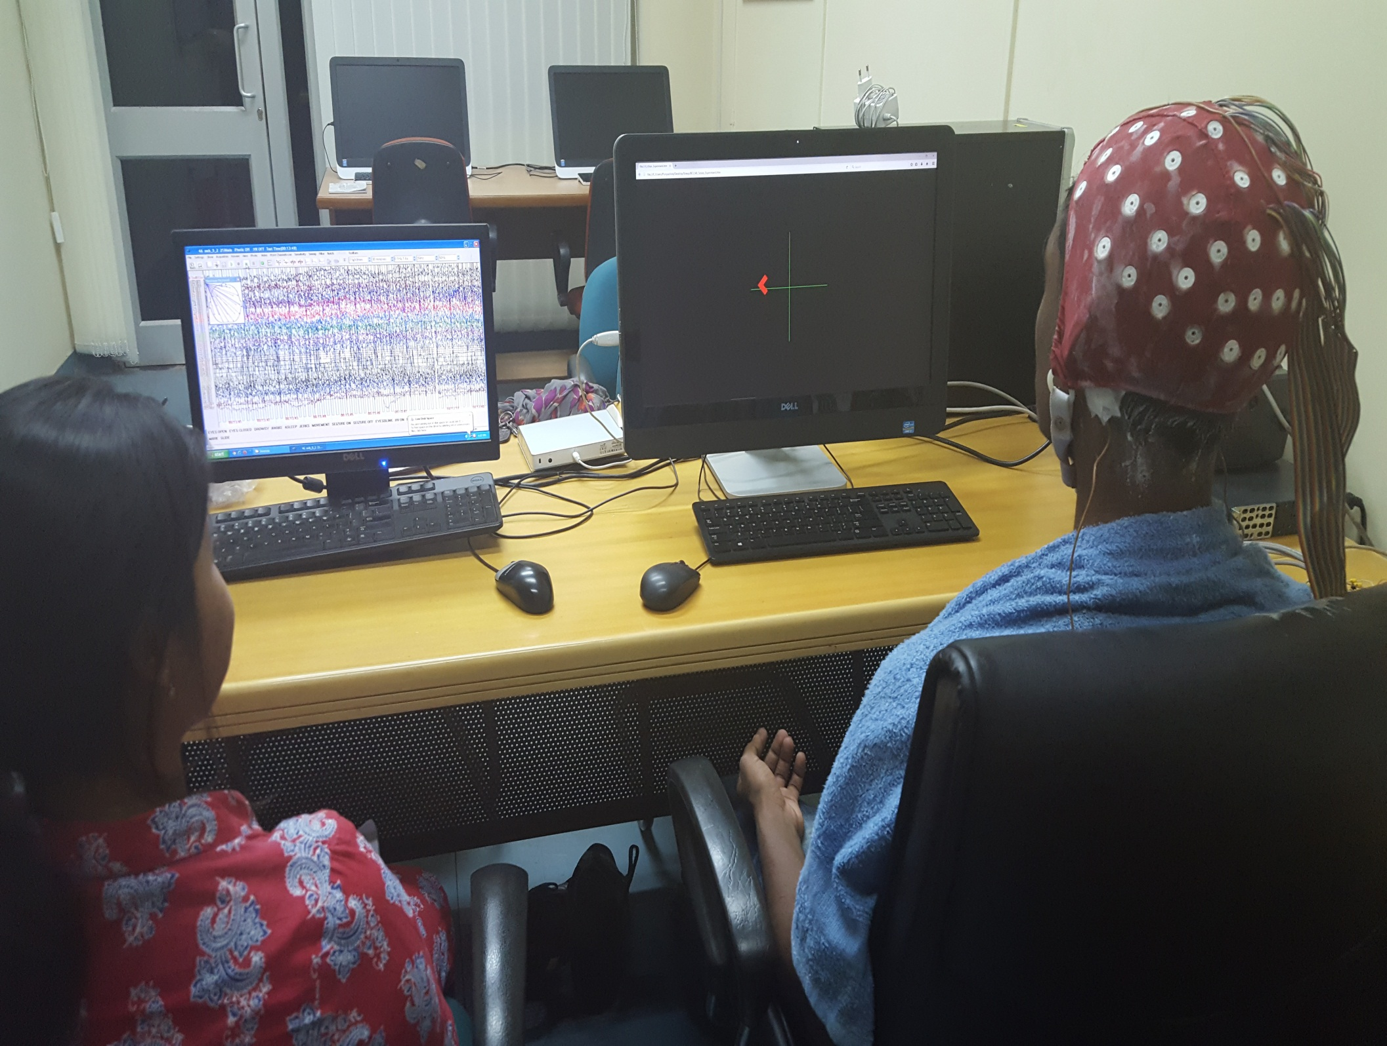
EEG Paradigms
01
P300
02
SCPs
03
SSVEPs
04
SMRs

Slide 3
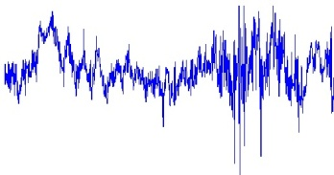

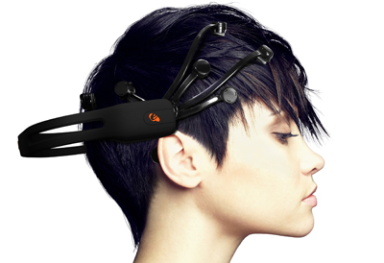
EEG based BCI System Development
Signal
enhancement
Artifact
processing
Noise
removal
Feature
identification
Feature
selection
Dimension
reduction
Signal Acquisition
BCI Signal Processing
Feature Engineering
Modeling
User’s Application
User
Text-Entry System
Vigilance
Detection
Adaptive
E-learning
Post
processing
Feature
classification

Slide 4
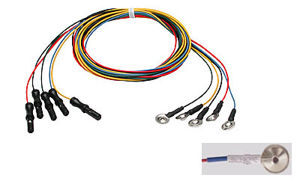
Recording the EEG
EEG electrodes:
Small metal discs usually made of stainless steel, tin, gold or silver covered with a silver chloride coating.
They are placed on the scalp in spatial positions using the International 10/20 system.
Fig: EEG cables showing the disc electrodes to which electrode gel is applied and applied to the subject's scalp.

Slide 5
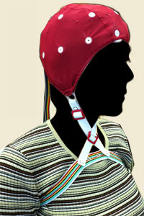
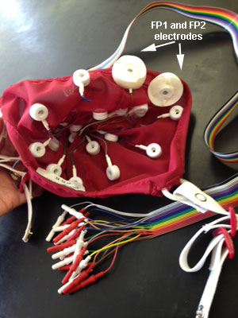
Recording the EEG
Fig: Many recording systems use a cap into which electrodes are embedded; this facilitates recordings when high density arrays of electrodes are needed or when comparing recording sites. The image to the right shows the inside of such a cap.

Slide 6
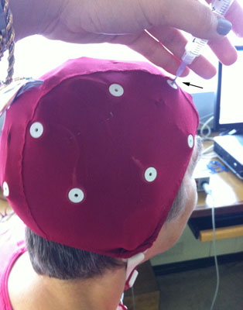
Recording the EEG
Electrode gel:
It acts as a malleable extension of the electrode, so that the movement of the electrodes cables is less likely to produce artifacts.
The gel maximizes skin contact and allows for a low-resistance recording through the skin.
Impedance
A measure of the impediment to the flow of alternating current, measured in ohms at a given frequency.
Larger numbers mean higher resistance to current flow.
The higher the impedance of the electrode, the smaller the amplitude of the EEG signal.
In EEG studies, should be at lest 100 ohms or less and no more than 5 kohm.
Fig: The electrolytic gel is injected into each cavity until a small amount comes out the hole in the mount. With a moderate amount of downward pressure, the syringe with a blunt needle is rapidly rocked back and forth.

Slide 7
EEG Artifacts
The electrical artifacts that is not of cerebral origin.
Anything that is NOT of cerebral origin is termed as ARTIFACT
Physiological and Electrophysiological artifacts.
Physiological – source (generated other than brain ie. Body)
Electrophysiological – arise outside the body - equipment and environment
Some readily distinguished, others closely resemble cerebral activity.

Slide 8
Principles to discriminate artifacts from EEG signals
Physiological activity has a logical topographic field of distribution with an excepted fall of the
voltage potentials
▪ Artifact have an illogical distribution that defies the principles of localization

Slide 9
KEY TO AN ARTIFACT FREE RECORDING
Good, clean preparation
Good hook-up, neatly bundled electrodes
Place jack-box close to patients head
Keep the subject cool, not cold
Unplug all electrical items close to patient, i.e. bed, radio, fan, etc.

Slide 10
EEG Artifacts

Slide 11
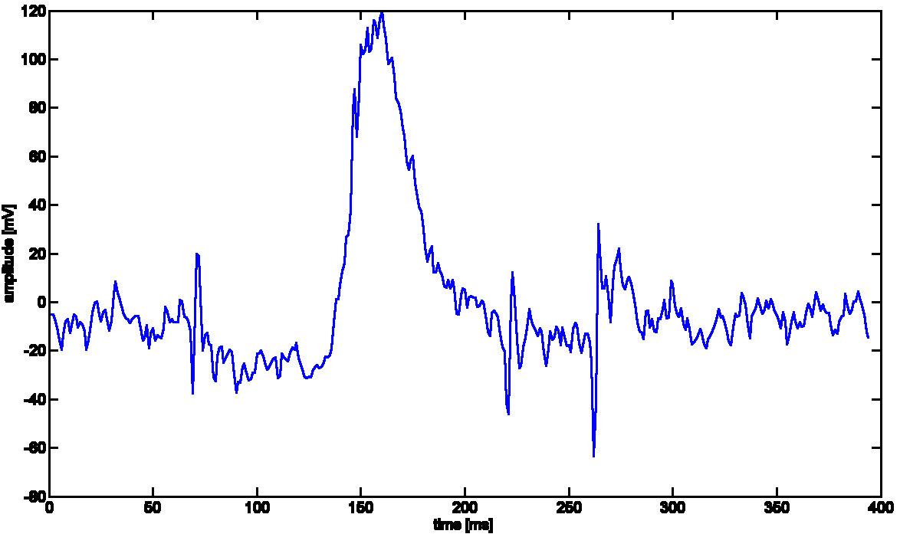
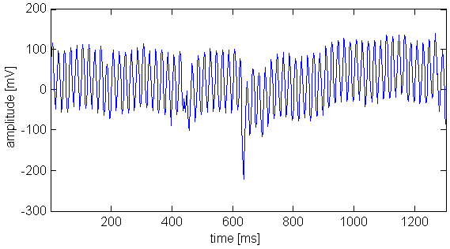
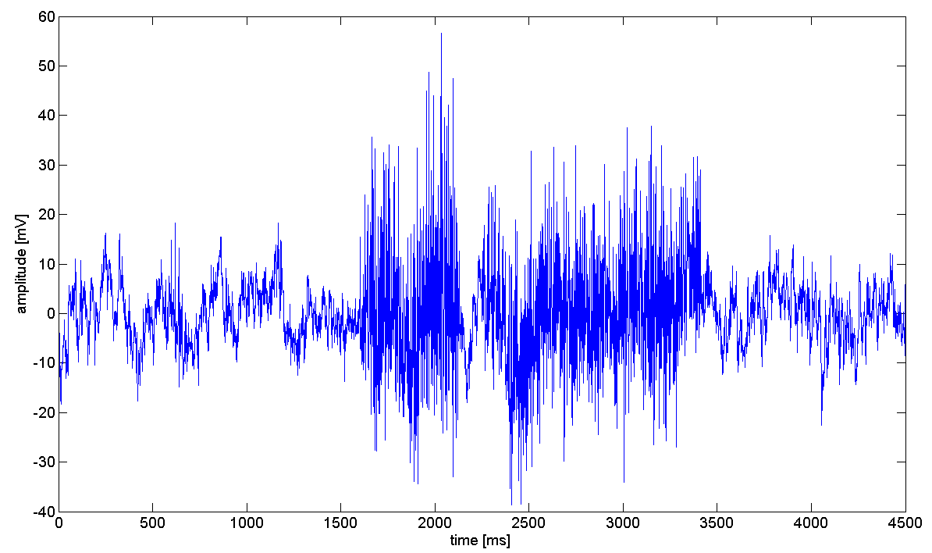
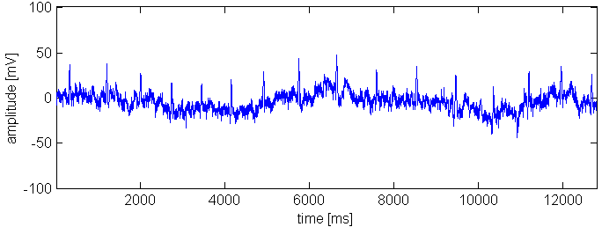
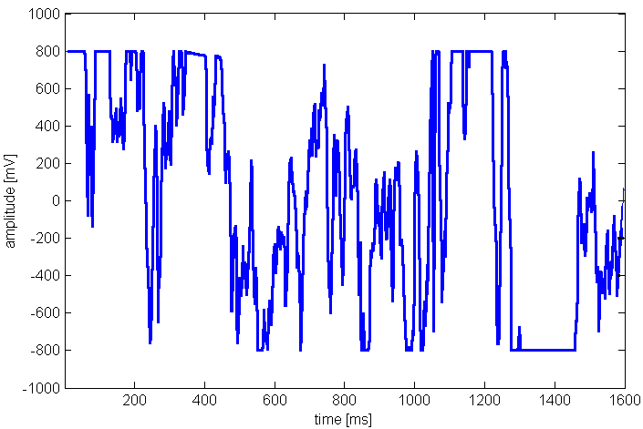
Captured EEG Signal
Ocular artifacts
Muscle artifacts
Cardiac artifacts
Power line 50/60 Hz
Electrode contact
Experiment protocol
Background
brain activity
Physiologic
Noise
Environmental
noise
Data Acquisition
Measured
signal
Eye blink
Power line
Jaw clenching
Heart rate
Electrode contact
Notes:
Brain electrical signal is noisy and can be modeled by an additive chain.
We first (1) have brain activity produced by the mental tasks specified in the experiment protocol.
To this signal, an unknown background brain activity is added (2). By background activity I mean all activity which is not specified in the experiment protocol.
Then, the physiologic noise is added. For example (3) eye movements, eye blinks and jaw clenching. Muscle artifacts have less effect on EEG when they are distant from the brain. For example, jaw movements and eye blinks produce a lot of artifacts, while shaking hands does not produce a lot of activity (oops, I would said “a lot of artifacts”).
Finally, environmental noise is added. For example (4) the power line noise or bad electrode contact.

Slide 12
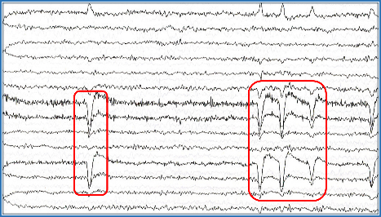
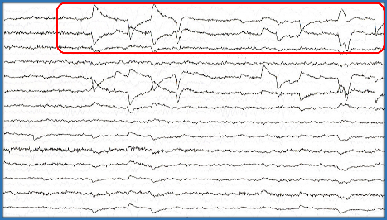
Ocular Artifacts
Blinks
Eye flutter
Lateral gaze
Slow/roving eye movement
Rapid eye movement
Electroretinogram (ERG)
Blink
Lateral Eye Movement

Slide 13
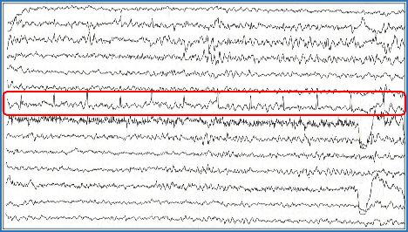
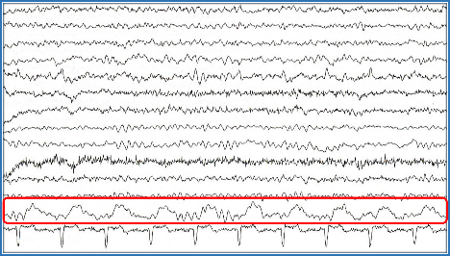
Cardiac Artifacts
Mechanical and Electrical
ECG, Pacemaker - Electrical
Pulse, Ballistocardiographic – Mechanical
Mostly these are high in amplitude and prominent in babies, obese and short neck persons.
Referential montages picks up cardiac artifacts.
Cardiac (Electrical)
Cardiac (Mechanical)

Slide 14
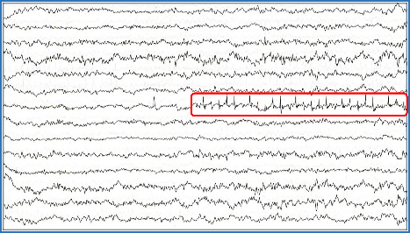
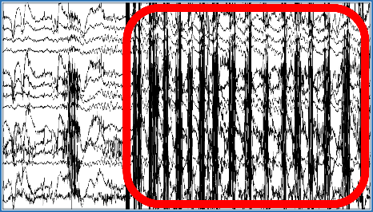
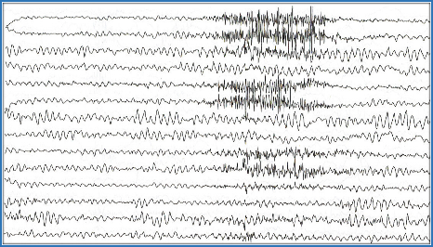
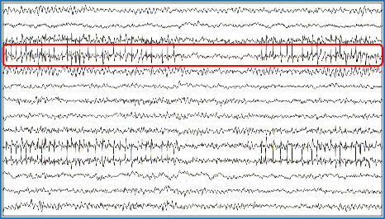
Muscle Artifacts
Glossokenetic (related to tongue movements, Chew and swallow)
Photomyogenic/ Photo-myoclonic (When flash of light falls over the face, the activity occurs due to myoclonus of the facial muscles).
Surface EMG (Electromyography) – used to measure electrical activity during muscle contractions and relaxation cycles.
Photomyogenic
Chewing
Electromyography (Scalp)
Electromyography (Facial)

Slide 15
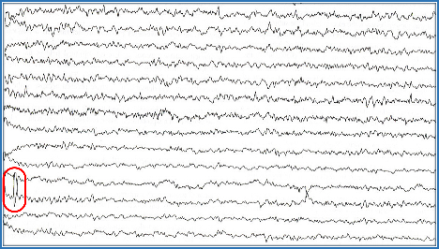
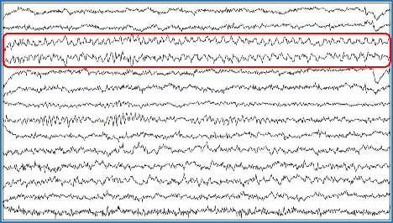
Electrode and Equipment Artifacts
Electrode pop, electrode contact, electrode movement
Perspiration – the process of sweating
salt bridge – differs from perspiration by low amplitude.
Movement artifacts - Movement of head, body and limbs produce irregular high voltage potentials
50/60 Hz ambient electrical noise.
Ventilators, circulatory pumps.
Telephone, mobile.
Electrode Pop
Electrode Movement

Slide 16
Electrode and Equipment Artifacts
Seen due to smearing of the electrode paste between electrodes or presence of perspiration across the scalp
Forms an unwanted electrical connection between the electrodes forming a channel
Perspiration artifact
- manifests as low amplitude
- undulating (smooth) waves - duration is typically greater than 2 sec
Slat bridge artifact - lower in amplitude
- not wavering with low frequency oscillation - typically include only one channel
- It may appear flat and close to isoelectric

Slide 17
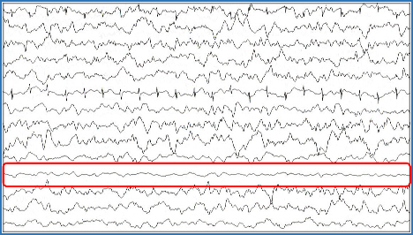
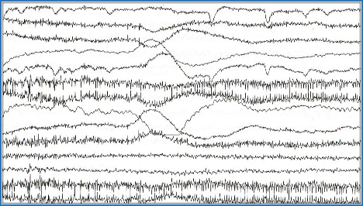
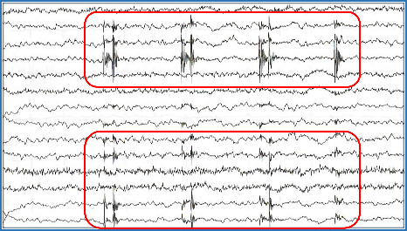
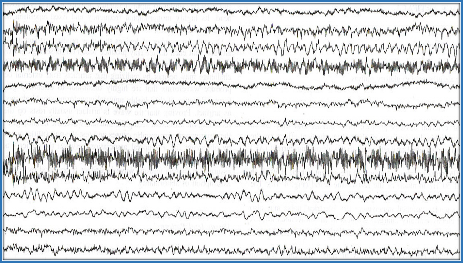
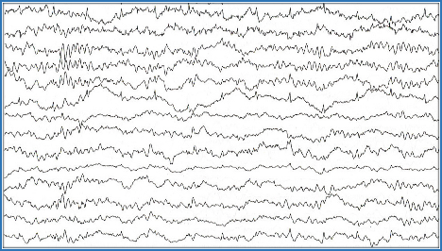
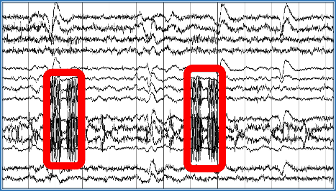
Electrode and Equipment Artifacts
Salt Bridge
Electrode Lead Movement
Electrical Motor
60 Hz
Perspiration
Phone

Slide 18
Thank You!

